Slide 1

Fake News Detection Using Machine Learning

Slide 2

Introduction
This project aims to detect fake news using NLP and machine learning.
We process text data, train models, and evaluate their performance.

Slide 3
Contents
Load Dataset
Preprocessing Text
Split Data
Word2Vec Model
Convert Text to Vectors
Train Random Forest Model
Predicting on Validation Data
Model Evaluation
Data Visualization
Model Comparison
Results

Slide 4
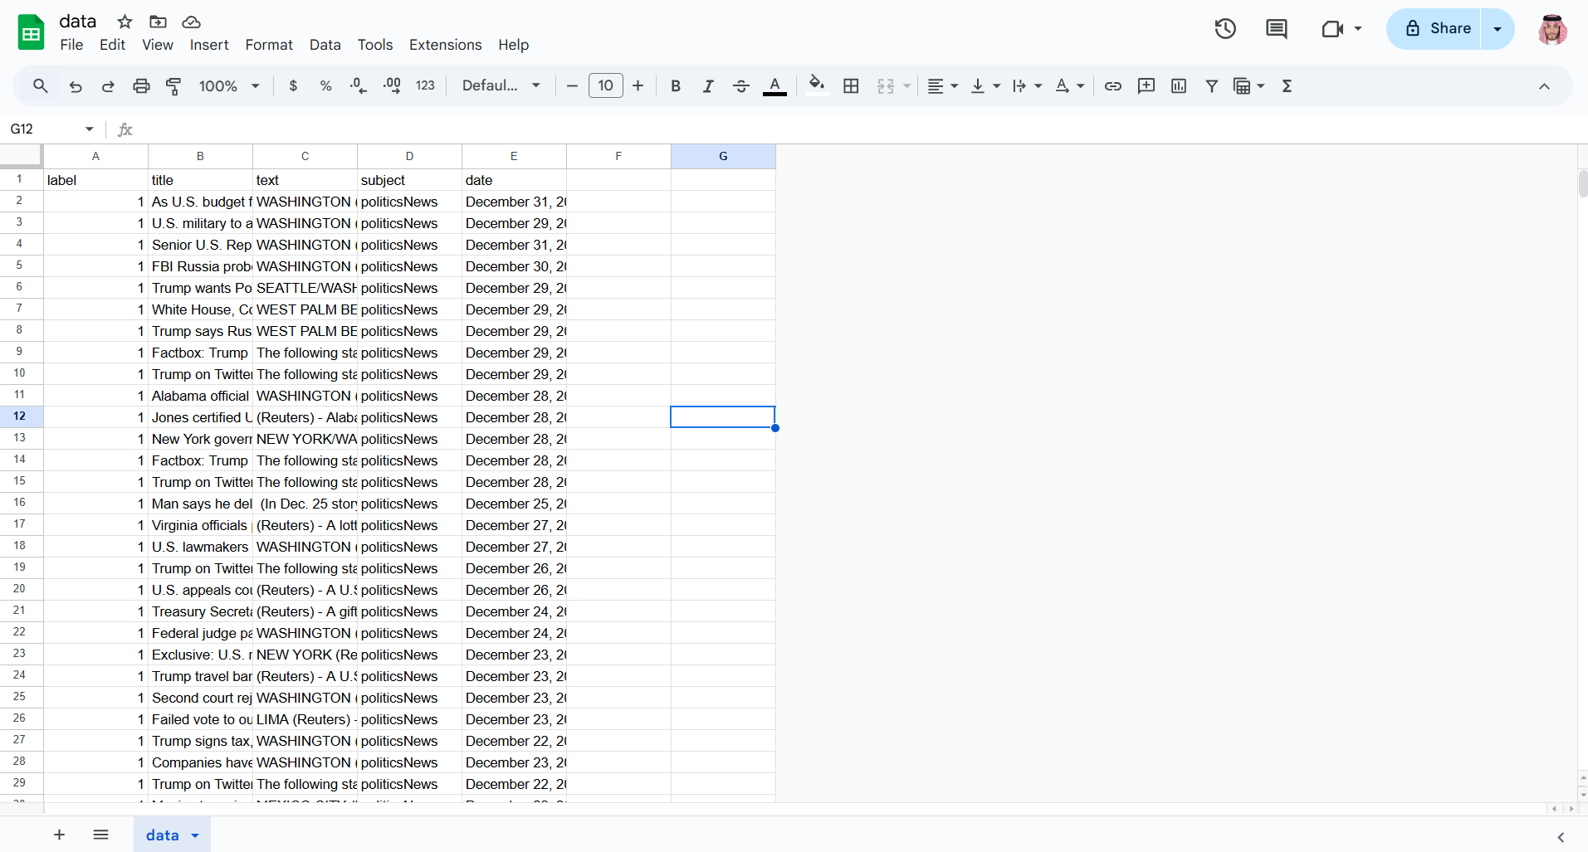
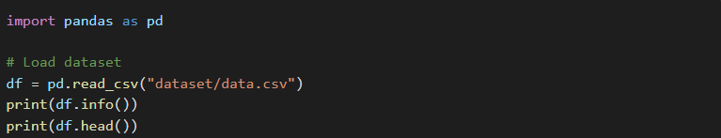
Load Dataset
We use pandas to read the dataset.
It contains news titles, content, topics, and labels (real or fake).

Slide 5
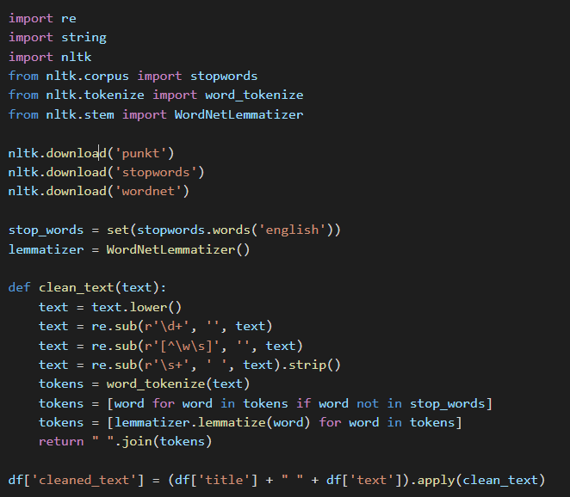
Preprocessing Text
Convert text to lowercase, remove numbers and punctuation.
Tokenize words, remove stop words, apply lemmatization.

Slide 6
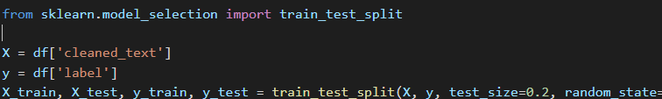
Split Data
Split dataset into 80% training and 20% testing.
Ensures model generalizes to new data.

Slide 7
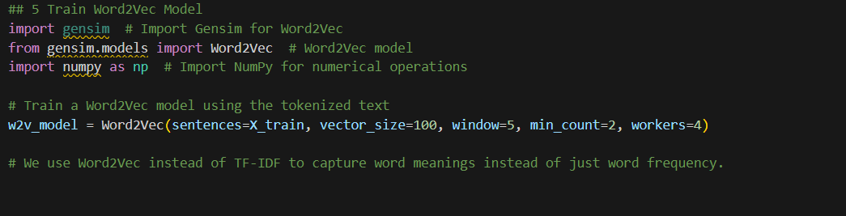
Word2Vec Model
Train a Word2Vec model to capture word meanings.
Used instead of TF-IDF to understand word relationship

Slide 8
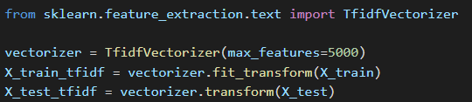
Convert Text to Vectors
Convert each document into a vector using the trained Word2Vec model.
Each document is represented as a numerical vector.

Slide 9
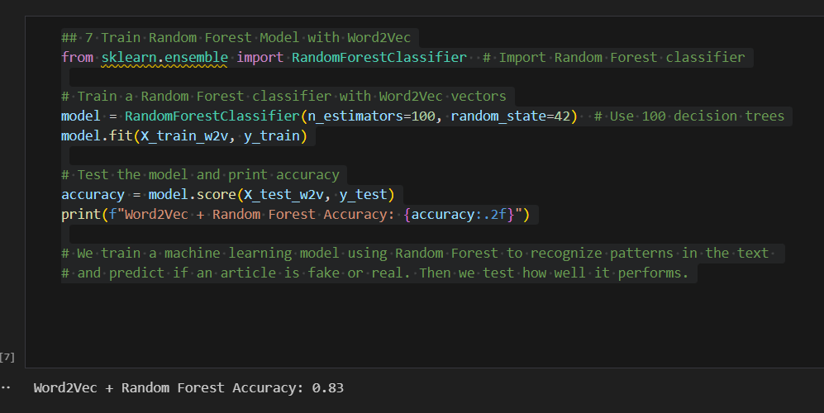
Train Random Forest Model
Train a Random Forest classifier using Word2Vec implications.
Helps detect patterns in the text.

Slide 10
Predicting on Validation Data
Clean and process new articles.
Use the trained model to predict if they are real or fake.

Slide 11
Model Evaluation
Prints accuracy, recall, and F1-score.
Helps understand model reliability.

Slide 12
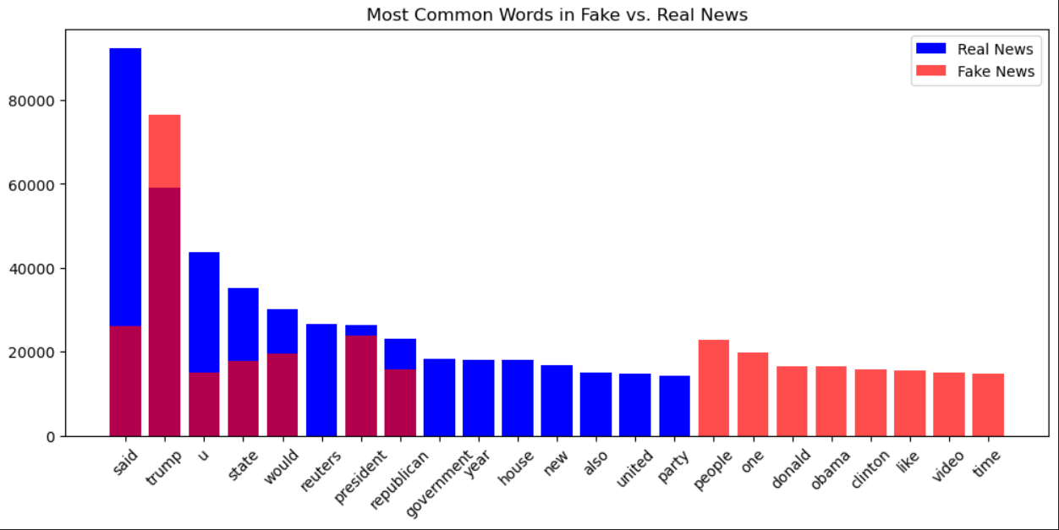
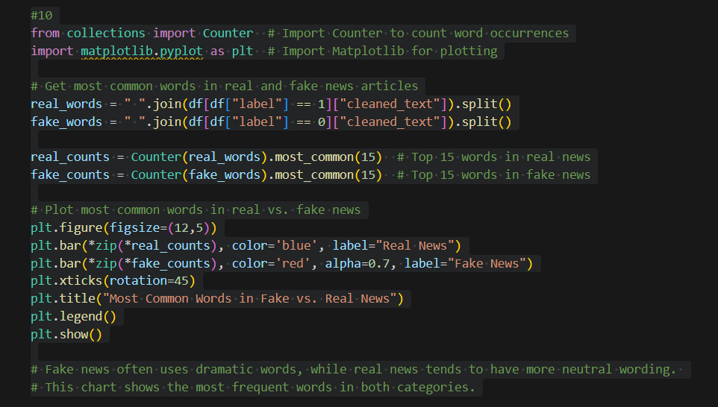
Data Visualization
Display most common words in real and fake news.

Slide 13
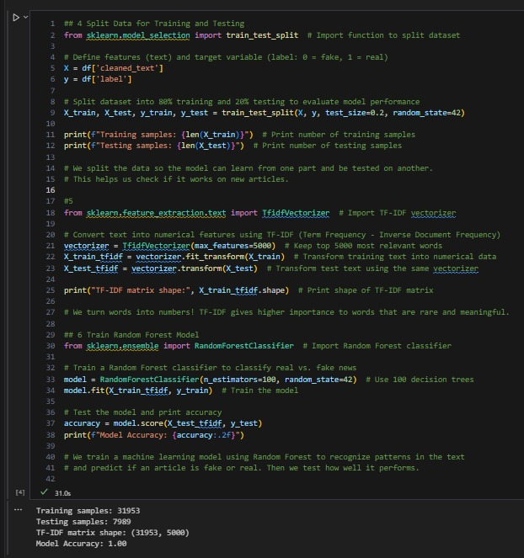
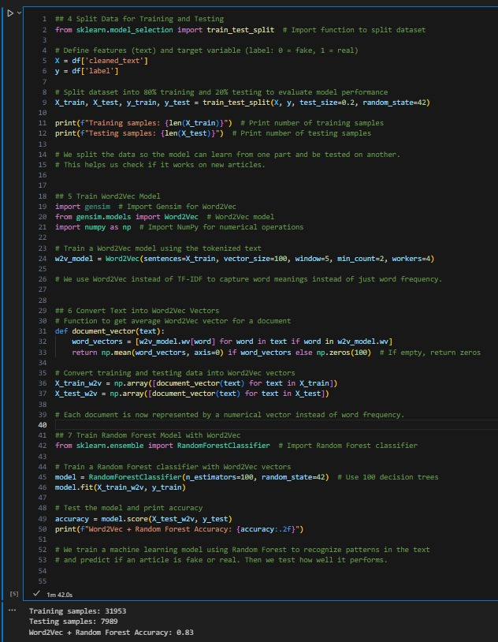
Model Comparison
TF-IDF(1)
WORD2VEC(1)

Slide 14
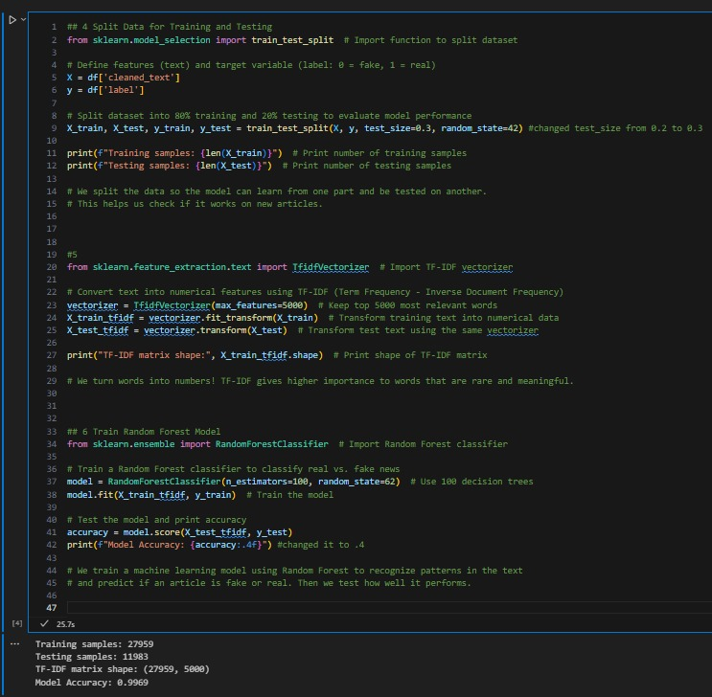
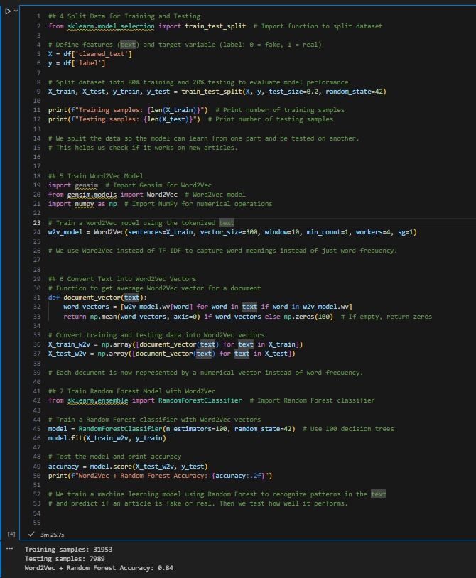
Model Comparison
TF-IDF(2)
WORD2VEC (2)

Slide 15
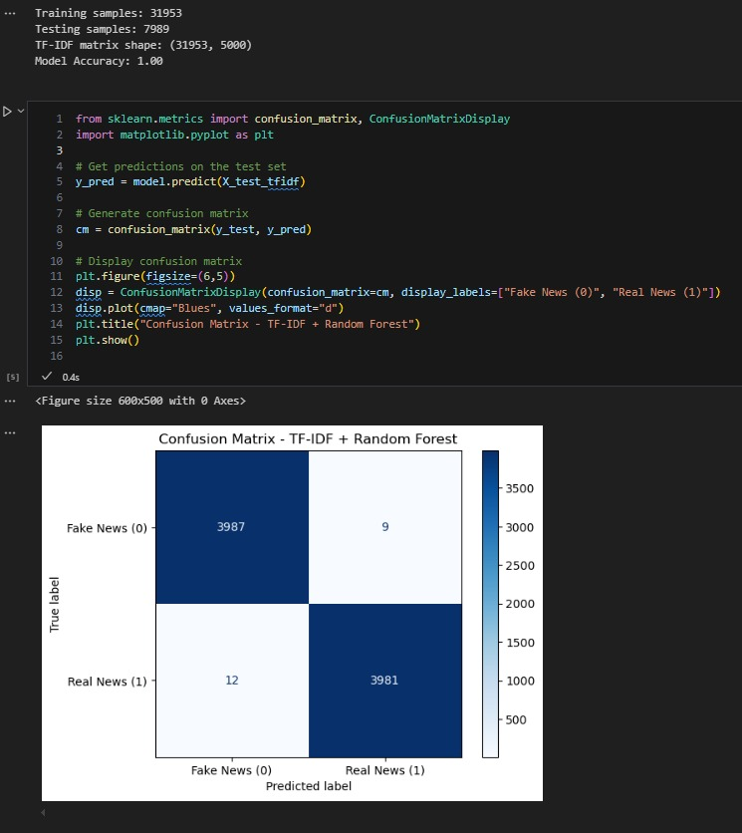
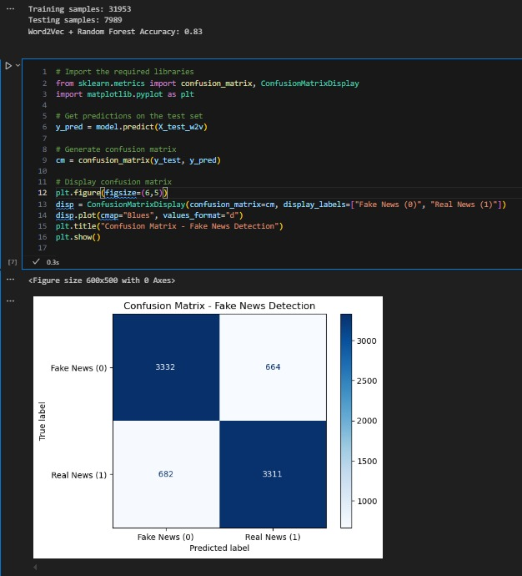
Results
TF-IDF(1)
WORD2VEC (1)

Slide 16


Results
TF-IDF(2)
WORD2VEC (2)

Slide 17
Thank you
Do you have any questions?

